Slide 1
Data Manipulation Pt. 2
Jeremy Bergmann - Omaha Data Science Academy

Slide 2
What is the need for data manipulation?
Creating new datasets & Combine disparate data sets
Perform common queries, aggregations, and joins
Adding, removing, or modifying data
Extracting and Storing Data
Creation/Extraction
Transformation data
Cleaning data
Storage & Retrieval
Notes:
Creation: creating tables and databases, the things
Storage: where data are stored
Cleaning: adding, removing, or modifying data
Retrieval: selecting only the data you want

Slide 3
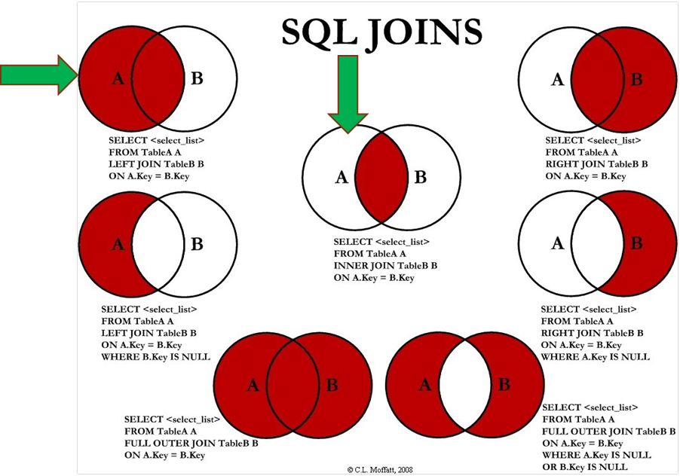
How do you combine data?
Answer:
SQL Joins can be done using WHERE or JOIN clauses!
Notes:
Most Common - INNER & LEFT, Sometimes Full Outer

Slide 4
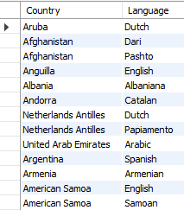
Inner Join - Example
Syntax SELECT <columns> FROM <table> AS <alias> <join type> JOIN <table> AS <alias>
ON <table alias>.<table column> = <table alias2>.<column>
Example - Official Languages SELECT a.Name as Country, b.Language FROM world.country as a INNER JOIN world.countrylanguage as b ON a.code = b.countryCode and b.IsOfficial ='T'

Slide 5
Left Join - Example
Question: “Which countries do/do not speak English as a language?”
Example
SELECT a.Name as Country, b.Language FROM world.country as a LEFT JOIN world.countrylanguage as b ON a.code = b.countryCode and b.`Language` ='English'
Notes:
Security: databases have additional security measures
Data integrity: data changes require intent
Customization: you can organize it best on your needs
Recovery: you don’t lose the data if there’s a catastrophic error
Learning curve: you have to learn how to manipulate it
Abstract: a less visual representation and demands more from the user

Slide 6
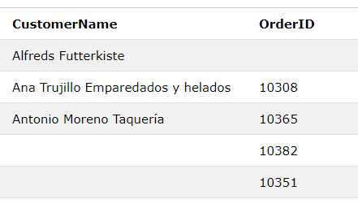
Full Outer Join - Example
Question: “List all Customer and Order Name, regardless of a customer placing an order, or an order without a customer name”
Example
SELECT a.CustomerName, b.OrderID FROM Customers as a FULL OUTER JOIN Orders b ON a.CustomerID=b.CustomerID ORDER BY a.CustomerName;

Slide 7
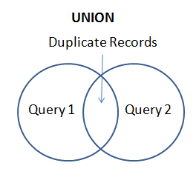
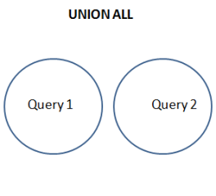
SQL Union & Union All
Purpose: The UNION operator is used to combine the result-set of two or more SELECT statements.
Each SELECT statement within UNION must have the same number of columns
The columns must also have similar data types
The columns in each SELECT statement must also be in the same order

Slide 8
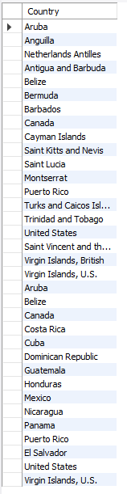
SQL Union All
Example
SELECT a.Name as Country FROM world.country as a Inner JOIN world.countrylanguage as b ON a.code = b.countryCode and b.`Language` ='English' Where a.Continent = 'North America' Union All SELECT a.Name as Country #, b.Language FROM world.country as a Inner JOIN world.countrylanguage as b ON a.code = b.countryCode and b.`Language`='Spanish' Where a.Continent = 'North America'
Question: “List all countries in North America that speak English or Spanish as a language, with duplication.
/

Slide 9
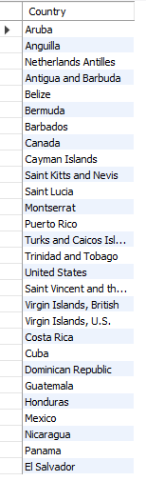
SQL Union
Question:
“List all countries in North America that speak English or Spanish as a language, with no duplication.
Example
SELECT a.Name as Country FROM world.country as a Inner JOIN world.countrylanguage as b ON a.code = b.countryCode and b.`Language` ='English' Where a.Continent = 'North America' Union SELECT a.Name as Country #, b.Language FROM world.country as a Inner JOIN world.countrylanguage as b ON a.code = b.countryCode and b.`Language`='Spanish' Where a.Continent = 'North America'

Slide 10

Exercises
SQL Joins & Unions
1. Using a union on the world.country table, combine all countries (repeating) with a life expectancy of > 80 years or a GNP > 1000000, with no repeats.
2. List all official languages spoken in the 'Southeast Asia' region.
3. List all the countries in North America, then match (left join) the “percentage” of the population that speaks English.
4. In the “world” schema, obtain the name of all cities in North America that have a population over 1M, where the primary language is English or Spanish (with repeats).
Notes:
Schema: https://gist.github.com/mdang/9a4a8063ebea3b829b8025746643ade1

Slide 11

Class Project
SQL Joins & Unions
To better understand the marketplace for video games and consoles, the COO would like to know the answer to the following questions:
What are the total sales for Action vs. Role-Playing games in North America by Year, since 2000?
During that time period, how does Role-Playing game sales compare vs. other Genres? (Combine all Countries)
What is the most popular console (by NA Sales) for Role Playing games, for consoles with a “first_retail_availablity” since 2000?
Obtain the average rank of games created in 2014, by genre. How does this order compare with the current video game rankings in the “console_game_sales” table?
Does this lead you to additional questions to research or data to gather?
Notes:
https://www.kaggle.com/max-mind/world-cities-database
https://www.kaggle.com/gregorut/videogamesales

